Slide 1
Aakansha industries
COMPANY PROFILE

Slide 2
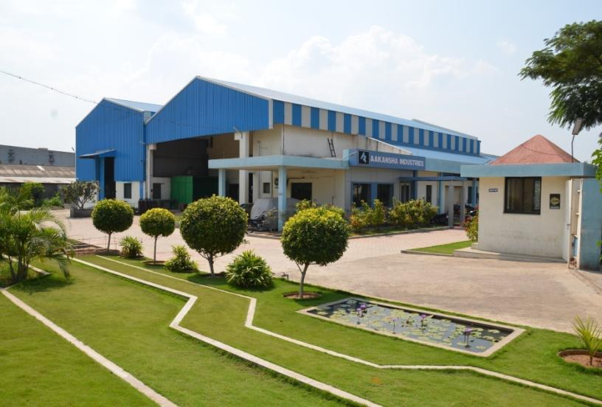
AAKANSHA INDUSTRIES
ADDRESS: A-17, MIDC, AHMEDNAGAR, MAHARASHTRA – 414111, INDIA.

Slide 3
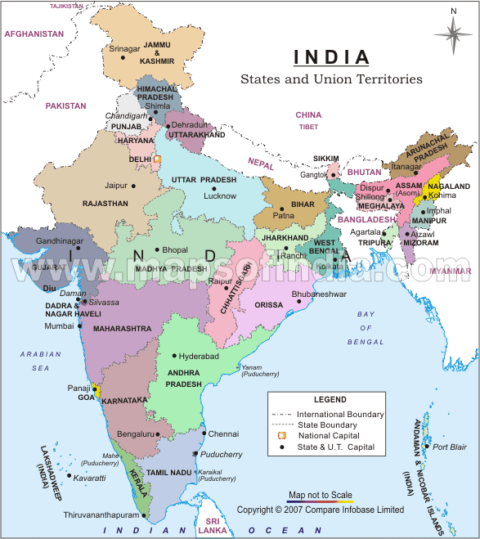
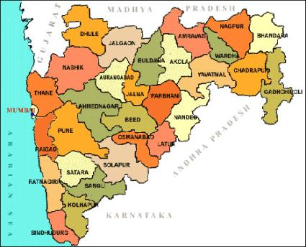
GEOGRAPHIC LOCATION
MANUFACTURING HUB IS
- WELL CONNECTED BY RAIL & ROAD TO ALL MAJOR CITIES
LOCATED AT A DISTANCE OF 250 KM FROM MUMBAI

Slide 4
COMPANY OVERVIEW
The company is established on 6000 Sqm plot area. Built up area is around 20,000 Sqm. Balance area is covered by Garden & Tree plantation. The company is proprietary. The proprietor Mr.A.G.PANSARE is Mechanical Engineering graduate having 25 years experience in Crompton Greaves Ltd (Avantha group) as production manager. He had worked in project Management, Quality assurance, production, ISO 9001 Quality system as MR and TQM After his resignation. He worked in SSI unit as a partner for 10 years and then he has established is our unit as Aakansha Industries in year 2007. Now his son AMIT PANSARE is assisting him to establish the business. He is now concentrating on automation and overseas business development and new ideas.

Slide 5
We are producing a wide range of quality product to suit a variety of applications. We are proud of our reputation for high quality work and which has lead to us becoming one of the most highly regarded team of skilled craft men and engineers in the Maharashtra region. Our company is ISO 9001 certified. We also practice six sigma Quality standards.
Company has two sections machine shop and fabrication shop. As we have started the business with machining the job on Horizontal Boring Machines & Lathe machines. We are machining different types of machine parts used in industries and sugar factories.
Then we started Fabrication job. Our first customer is Suzlon Generator Ltd. Pune. We manufacture the heat exchanger and air duct for 1.5 mw for their generators. Also we manufacture same type of heat exchanger for ABB ltd Gujarat.
Now our major customer is Crompton Greaves Ltd and Cummins Generator Technologies. We supply fabricated alternator frames from 20 KVA to 2000 KVA.
In our machining shop we have three horizontal boring machines, 5 lathe machines and 3 radial drilling machines. We are equipped with measuring facilities required for manufacturing above mentioned jobs.

Slide 6
COMPANY VISION
“TO BE
A WORLD CLASS MANUFACTURER
OF ENGINEERING PRODUCTS
WITH SPECIFIC FOCUS ON
VALUE CREATION FOR THE SOCIETY”

Slide 7
COMPANY MISSION
To improve productivity through
continuous improvement.
To strive for excellence by
standardizing the systems & work
procedures.
To assure Safe & Healthy Workplace.

Slide 10
PLANT LAYOUT

Slide 11
QUALITY POLICY
We are committed to manufacture and supply world class Fabricated & Machined components as per customer requirement.
To achieve total customer satisfaction, we shall continually improve -
Product Quality
Skill of employees
On Time Delivery
Quality Management System

Slide 12
MANUFACTURING FACILITIES
Machine Name & Make | Capacity
Horizontal Boring Machine WMW | 1400 X 1600 mm Table 130 mm Spindle
Horizontal Boring Machine Titan | 1220 X 1520 mm Table 100 mm Spindle
Horizontal Boring Machine Cornac | 1200 X 1200 mm Table 90 mm Spindle
Center Lathe Rajendra | 16 Feet 36” Chuck
Center Lathe Rajendra | 16 Feet 36” Chuck
Center Lathe Rajendra | 16 Feet 36” Chuck
Center Lathe Perfect | 12 Feet 18” Chuck
Radial Drill Machine SCPEL, Hungery | 75 mm
Radial Drill Machine VR4 | 50 mm
Radial Drill Machine | 50 mm
Plate Rolling Machine | Thickness 20mm Length 2000mm

Slide 13
KEY CUSTOMERS
1. CUMMINS GENERATOR TECHNOLOGIES, Ahmednagar
2. CROMPTON GREAVES Ltd (Avantha group) Ahmednagar
3. SUZLON GENERATORS Ltd, Pune
4. ABB Ltd, Baroda Gujarat

Slide 14
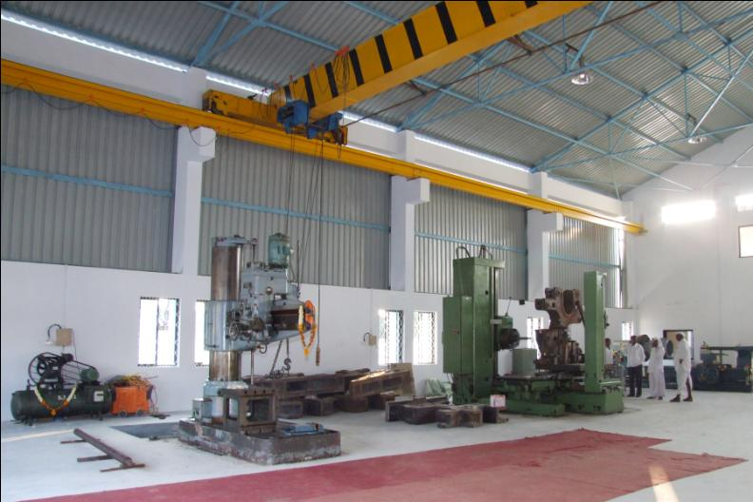
Machining shop

Slide 15
Fabrication shop

Slide 16
SUZLON HEAT EXCHANGER

Slide 17
Suzlon Air to air duct

Slide 18
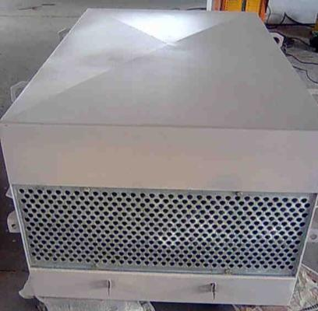
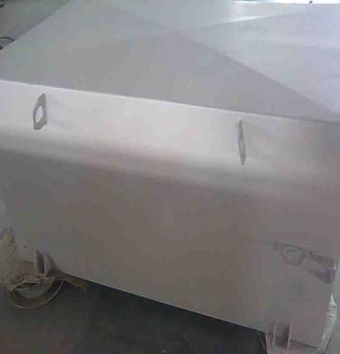
ABB HEAT EXCHANGER

Slide 19
Crompton Greaves Ltd (AVANTHA GROUP) alternators frames
Alternator Frame 355 S

Slide 20
Cummins Genterator technologies generators Frames
HC 4 CDE PCC FRAME
P 7 ABC FRAME

Slide 21
Cummins generator technologies Arrow frame

Slide 22
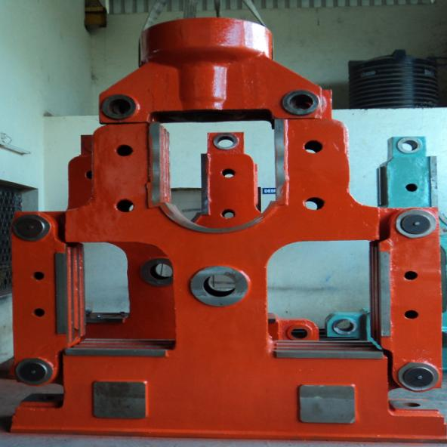
SUGAR FACTORY HEAD STOCK
Specification :
Head stock is main machine structure of Sugar plant used for crushing the sugarcane.
We done the Machining of this job on Horizontal Boring machine
Job height is about 3m
Apprx weight of about 10 ton

Slide 23
SUGAR FACTORY HEAD STOCK
Specification :
Head stock is main machine structure of Sugar plant used for crushing the sugarcane.
We done the Machining of this job on Horizontal Boring machine
Job height is about 1m
Apprx weight of about 1 ton

Slide 24
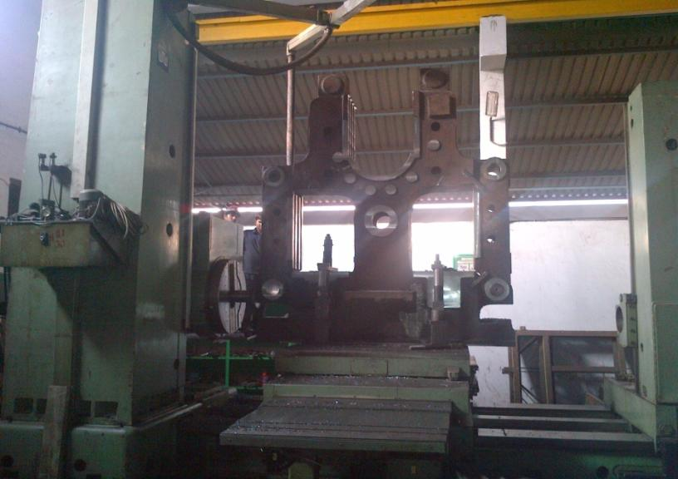
HORIZONTAL BORING MACHINE- WMW MAKE
Specification :Spindle -130mm Table size – 1400 mm X 1600 mm
Cross slide – 2500mm, Longitudinal slide- 2500mm, Vertical slide – 2700mm
Max load on table 10 ton, Fitted with DRO for all axis

Slide 25
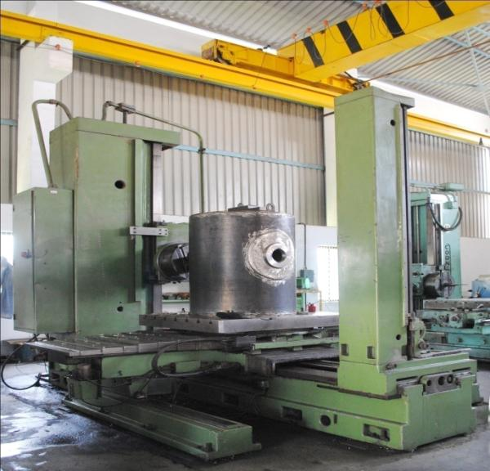
HORIZONTAL BORING MACHINE- TITAN MAKE
Specification :
Spindle -100mm
Table size – 1220 mm X 1520 mm
Cross slide – 1500mm
Longitudinal slide- 1150mm,
Vertical slide – 1800mm
Max load on table 5 ton
Fitted with DRO for all axis

Slide 26
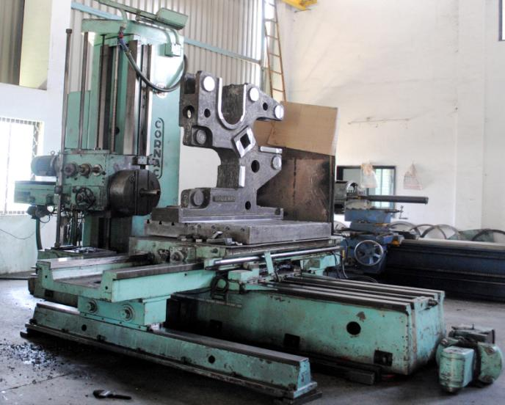
HORIZONTAL BORING MACHINE- CORNAC MAKE
Specification :
Spindle -90mm
Table size – 1200 mm X 1200 mm
Cross slide – 1600mm
Longitudinal slide- 1200mm,
Vertical slide – 1600mm
Max load on table 5 ton
Fitted with DRO for all axis

Slide 27
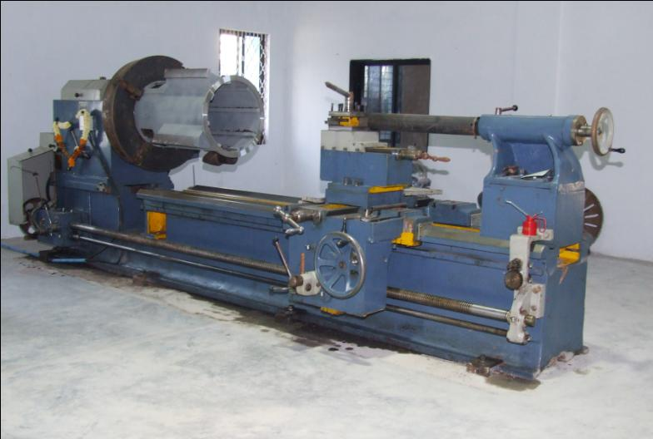
LATHE MACHINE- RAJENDRA MAKE
Make : Rajendra , Punjab
Capacity: Bed Length 16 feet long and Chuck diameter 36 inch, Centre Height – 25 inch
We are have 3 machine like this.

Slide 28
Cnc PLATE ROLLING MACHINE
Make : Davi Machine
Capacity: 2000 mm x 10 mm
Roller Length 2050 long,
4 rolls Machine with CNC operated

Slide 29
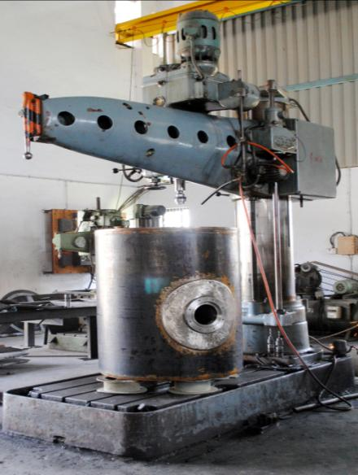
RADIAL DRILLING MACHINE
Make : SCPEL , Hungery
Capacity: Max. 75mm

Slide 30
Company Details
VAT TIN No.: 27940597727 V w.e.f. Dt 23-03-07
CST TIN No.: 27940597727 C w.e.f. Dt 23-03-07
Central Excise Reg No. ABBPP9392CEM001
Range : II
Division : Ahmednagar
Commissionerate: Aurangabad
Service Tax No.: ABBPP9392CST001 Dt 27/01/2009

